Slide 1

Building a Better Internet
Speaker: Colton White
If you do not have brains you follow the same route twice. — Greek proverb

Slide 2
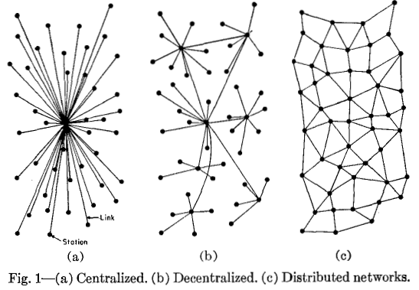
What is a meshnet?
Notes:
https://www.youtube.com/watch?v=1tEkyLOh-tY

Slide 3

What is a meshnet?
https://www.youtube.com/watch?v=1tEkyLOh-tY
Notes:
https://www.youtube.com/watch?v=1tEkyLOh-tY

Slide 4

Why use a meshnet?
Who owns the data passing through the “pipes?”
Responsible for spam or illegal content? (SOPA, EARN IT)
Is digital privacy a basic human right? (4th Amendment)
Should encryption be illegal? (EARN IT)
Who draws the line between satire and propaganda?
Choose between natural/government monopolies?
(Open Internet Order, Net Neutrality)
…self-evident with meshnets!

Slide 5
Assumptions
Meshnets and otherwise distributed networks will improve many forms of communication, enabling freedom of information
Distributing means of communication allows for some degree of autonomy for participants

Slide 6
History
2009: Bitcoin provides a method for decentralized banking and money transfer with a global currency (beginning of blockchain)
2010: China Telecom diverted 15% of world’s Internet traffic for up to 18 minutes
BGP route leaks are a common enough occurrence to warrant change in infrastructure
2015: Ethereum introduces a global virtual machine as a blockchain
2015: IPFS provides global, distributed file storage
2017: Turkish gov blocks access to Wikipedia (subsequently hosted on IPFS to mitigate censorship)
2019: Mesh messaging app Bridgefy usage up 3685% amidst Hong Kong protests

Slide 7




Solutions: Application Layer
Bitcoin: trustless consensus (proof of work)
Monero = crypto with zero-knowledge proof
ZeroNet: merges blockchain & BitTorrent
Can serve dynamic websites (“zites”)
Ethereum: Turing-complete VM over blockchain
Many “dapps” operate using Ether as “gas”
IPFS for hosting static websites and files
Operates on Merkle DAG routed with DHT
Like a Git repository shared over BitTorrent
Content-addressed using hashes

Slide 8



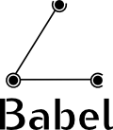
Solutions: Layers 2 & 3 (OSI)
batman-adv
Layer 2 - Makes networked devices act as though part of the same switch -- parent protocol B.A.T.M.A.N. is layer 3
cjdns
IPv6-addressed, e2e encrypted, load seeks “preferred nodes” in DHT (backhaul) -- still active but largely replaced by yggdrasil
Yggdrasil
cjdns, but balances load equally and routes follow spanning tree
babel
Optimizations to adjust to wireless/wired networks
Althea: babel + ether (pay-as-you-go service model)

Slide 9
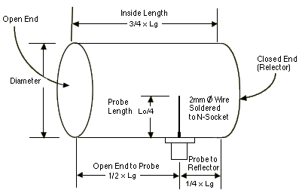
Solutions: Layer 1 (OSI)
https://www.wikarekare.org/Antenna/WaveguideCan.html
for the University Experience™
https://startyourownisp.com/posts/hardware-platform/
more professional hardware (Ubiquiti routers are usually used)

Slide 10
Ethics
With great power comes great responsibility
Greater potential for spread of reasonably illegal content
don’t anonymize the network
Can still be vulnerable to DDoS attacks
require permission from any participant to enter network
require proof of work to send data over network
On the other hand…
Censorship-resistant
Backed by community’s interest, not corporate/legal
Democratic, promotes individual liberties

Slide 11


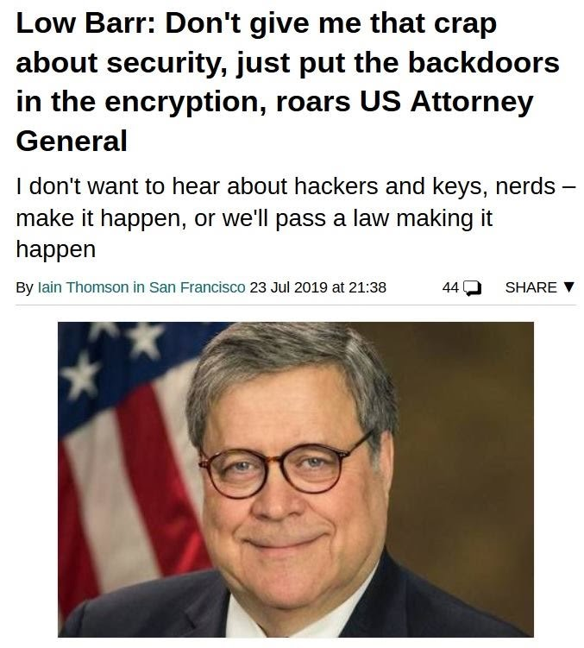

In Conclusion...

Slide 12
Sources
Benet, J. (2014, July 24). IPFS - Content Addressed, Versioned, P2P File System. Retrieved November 11, 2019, from https://github.com/ipfs/ipfs/blob/master/papers/ipfs-cap2pfs/ipfs-p2p-file-system.pdf.
Bulkin, A. (2016, May 3). Explaining blockchain - how proof of work enables trustless consensus. Retrieved from https://keepingstock.net/explaining-blockchain-how-proof-of-work-enables-trustless-consensus-2abed27f0845?gi=3c4942d923f.
Chroboczek, J. (n.d.). Babel — a loop-avoiding distance-vector routing protocol. Retrieved November 10, 2019, from https://www.irif.fr/~jch//software/babel/.
Cjdelisle. (2018, June 22). cjdelisle/cjdns. Retrieved November 11, 2019, from https://github.com/cjdelisle/cjdns/blob/master/doc/Whitepaper.md.
Dale, B. (2018, February 6). Turkey Can't Block This Copy of Wikipedia. Retrieved from https://observer.com/2017/05/turkey-wikipedia-ipfs/.
Eichler, A. (2013, October 26). Why Did 15 Percent of All Web Traffic Briefly Go Through China? Retrieved from https://www.theatlantic.com/technology/archive/2010/11/why-did-15-percent-of-all-web-traffic-briefly-go-through-china/343377/.
Killeen, A., Killeen, A., & Pinterest. (2015, January 5). Distributed Networks. Retrieved from http://venturehousela.com/2015/01/05/distributed-network/.
Mailonline, R. F. (2019, October 19). Hong Kong activists wear Joker and Winnie-the-Pooh masks. Retrieved from https://www.dailymail.co.uk/news/article-7590823/Hong-Kong-activists-wear-Joker-Winnie-Pooh-masks.html.
Play: A P2P Distributed Torrent Site That's Impossible to Shut Down. (2016, March 1). Retrieved from https://torrentfreak.com/play-p2p-impossible-shutdown-160301/.
Tapscott, D., & Tapscott, A. (2016). Blockchain revolution: the brilliant technology changing money, business and the world. Toronto: Penguin Random House Canada.
Yggdrasil-Network. (n.d.). yggdrasil-network/yggdrasil-go. Retrieved November 11, 2019, from https://github.com/yggdrasil-network/yggdrasil-go/blob/master/doc/Whitepaper.md.

